Slide 1


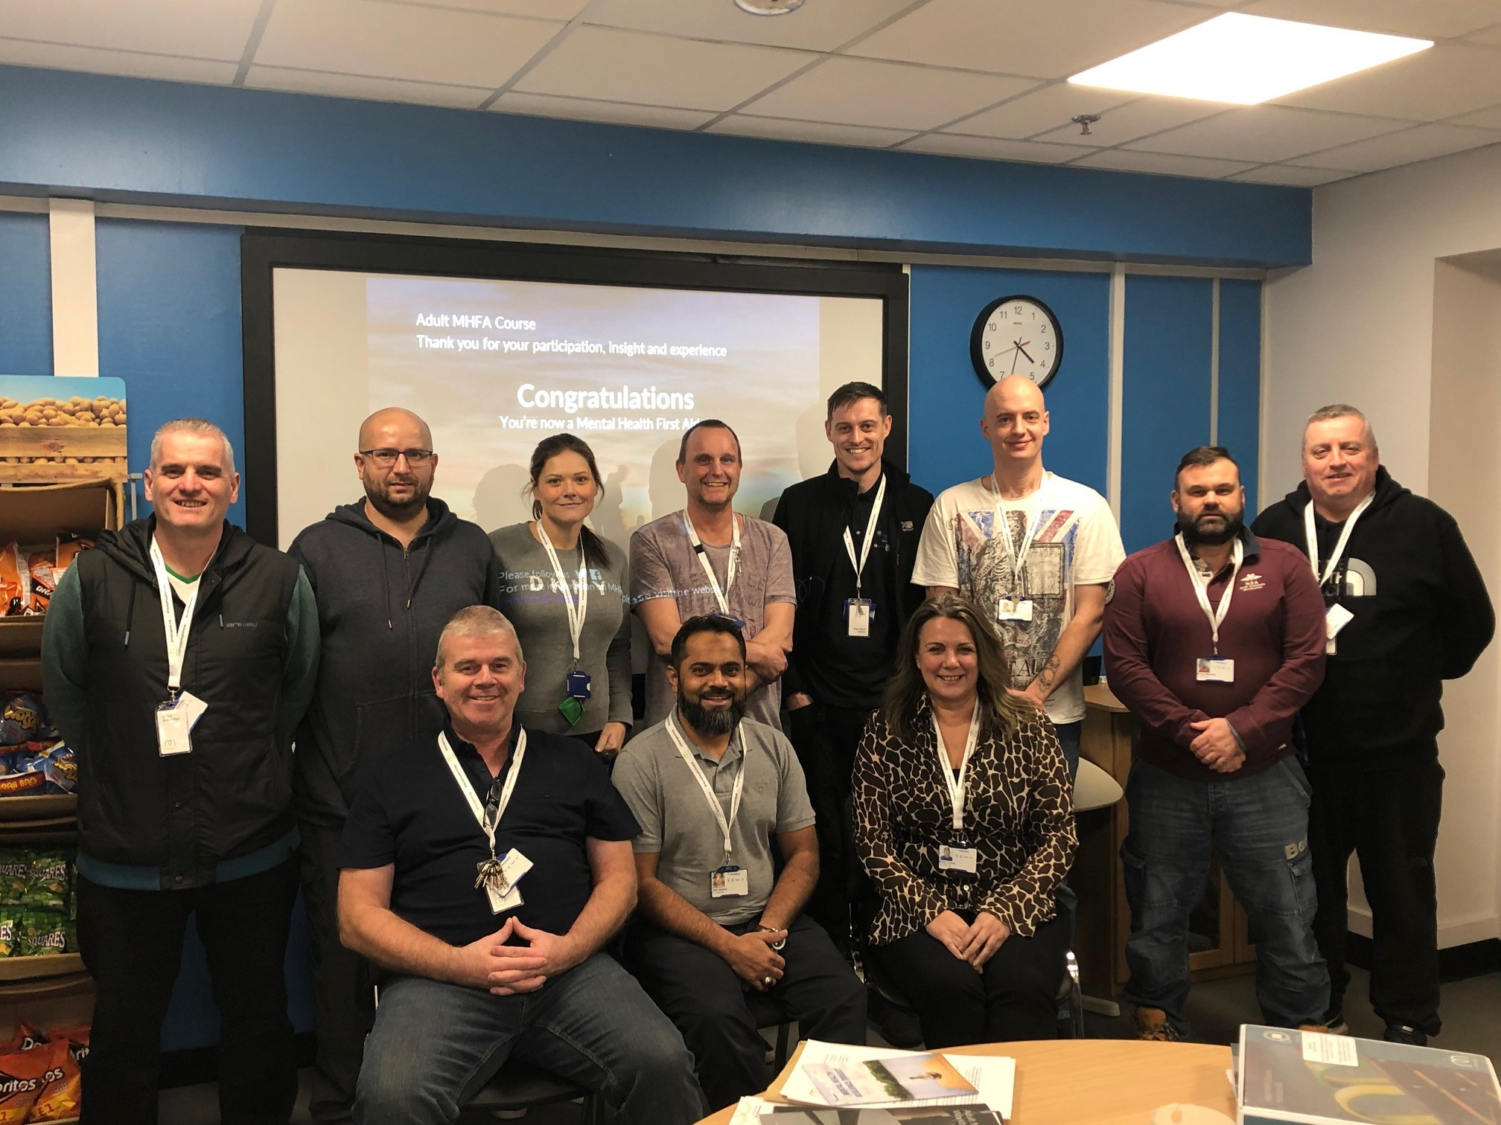
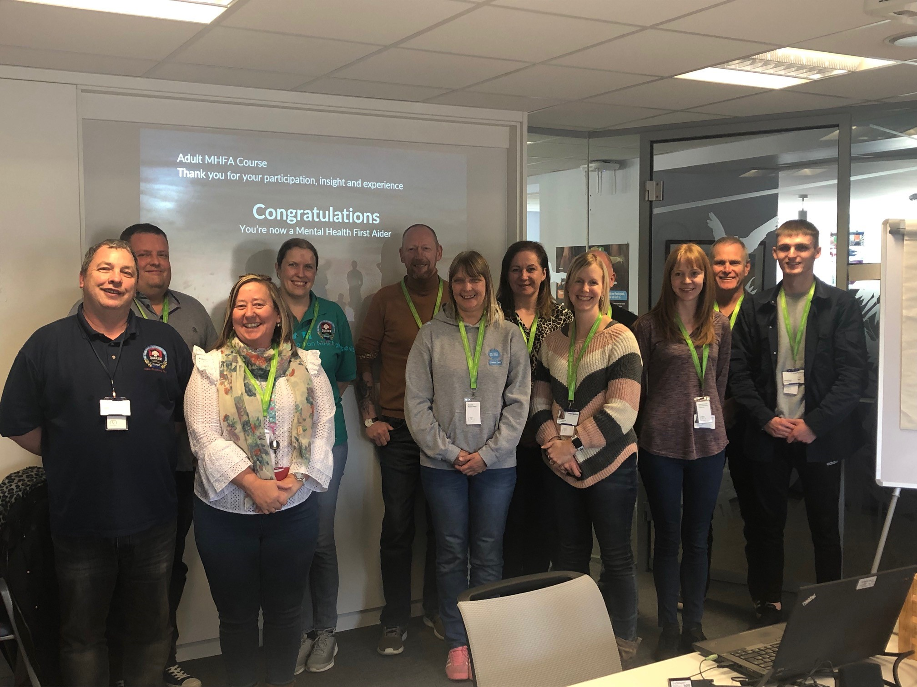


MENTAL HEALTH FIRST AIDERS We now have over 170 registered Mental Health First Aiders who are trained and ready to support colleagues at PepsiCo What is a Mental Health First Aider? Listen, reassure and respond Spot the early signs of a mental health issue Feel confident to provide initial help and signposting to appropriate support Promote recovery of good mental health Help to remove the stigma that exists around mental health To find out who the MHFA are at your site please see the First Aid board or look out for the green lanyards Express an interest in becoming an accredited Mental Health First Aider by emailing joanne.gardner@pepsico.com

