Slide 1



Supporting Carers in the Workplace: Key Stats

Slide 2

Every day 6,000 people become carers
Carers look after loved ones who are older, disabled or seriously ill.
Caring can affect anyone, at any age, at any time and can last a lifetime.
Carers UK aims to make sure no one has to care alone.

Slide 3
Caring and employment
Every year, over 2 million people become carers, some overnight, some more gradually – so there is a new population of carers in the workforce every day
Over 7 in 10 working carers have felt lonely or isolated in the workplace as a result of their caring responsibilities.
The average person has a 50:50 chance of caring by age 50, long before retirement age.
Around 8 out of 10 carers are of working age, ie between 16 and 65.
90% of working carers are aged 30+ - in their prime employment years.

Slide 4

Business benefits
Improved recruitment
Attract a wide range of skills
Improved retention
Keep skilled and experienced staff
Improved resilience
When they are supported carers feel less stressed and report better wellbeing
Improved results
Better engagement and improved productivity
Notes:
These points show the business benefits of supporting carers in the workplace.
There is evidence to show that the impact of staff turnover, absence and stress as a result of juggling work and caring could be costing UK businesses over £3.5 billion every year, so there are significant savings to be made by better supporting carers to manage work alongside caring.
Leading companies have suggested that cumulatively, UK companies could save up to £4.8 billion a year in unplanned absences and a further £3.4 billion in improved employee retention by adopting flexible working.

Slide 5
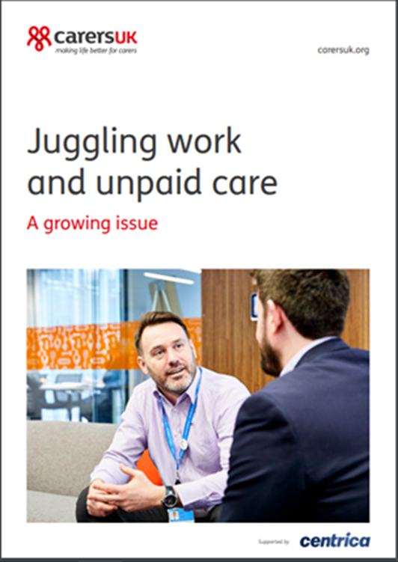
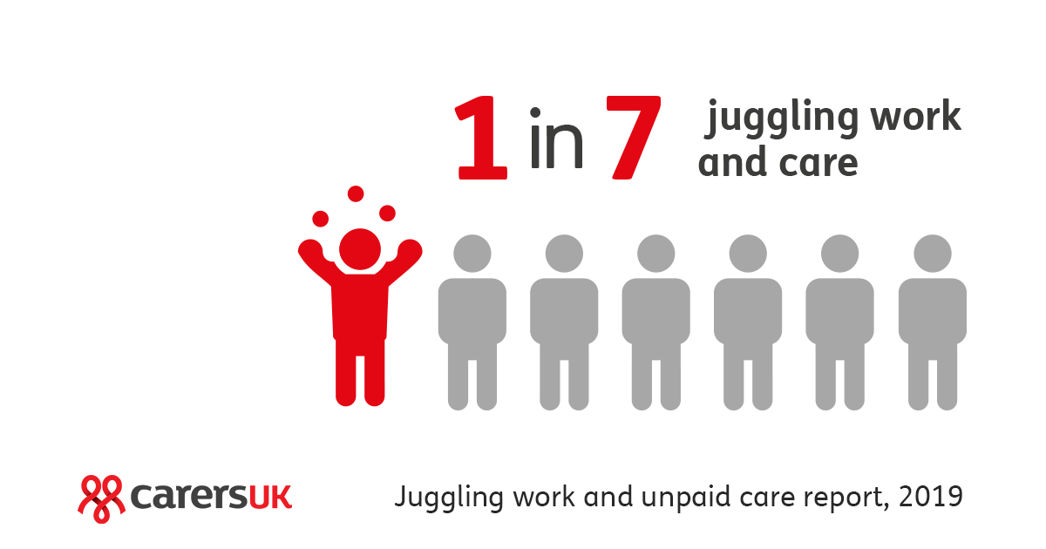
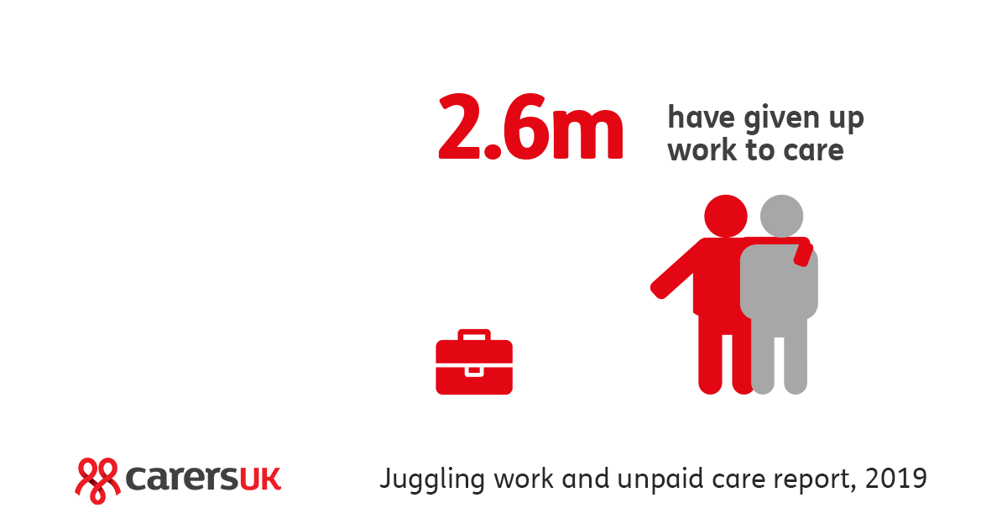
Report released 8 February 2019
Notes:
These figures have been taken from a survey Carers UK conducted in 2019 about the growing issue of juggling work and care.
The 1 in 7 figure found in our research is an increase from the 2011 census where it was found 1 in 9 people were juggling work and care in the UK.
Another key finding is the top three interventions that workers thought would be most helpful if they were caring alongside work. These three interventions are, a supportive line manager/employer, flexible working, and additional paid care leave of between 5-10 days.
You can find the research report here: https://www.employersforcarers.org/resources/research/item/1460-juggling-work-and-unpaid-care-a-growing-issue

Slide 6


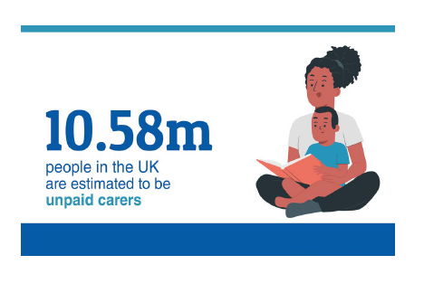
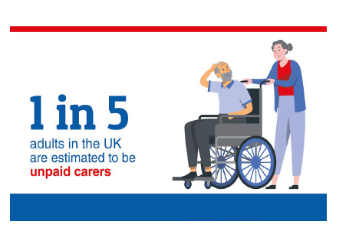
How many people are caring?

Slide 7

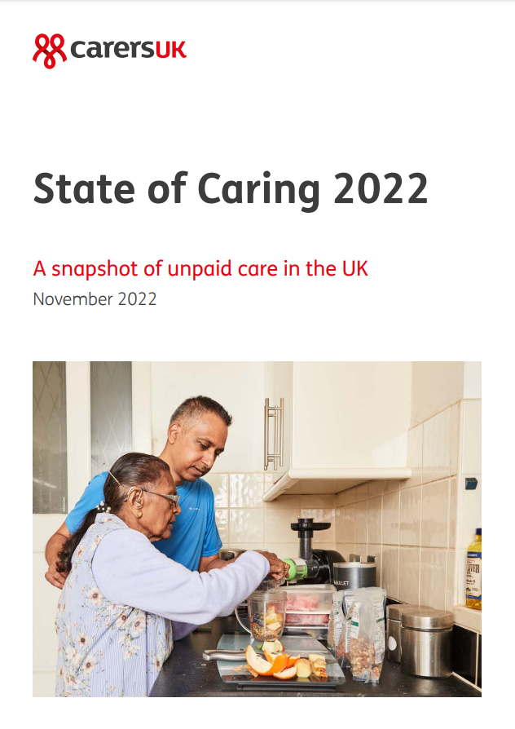
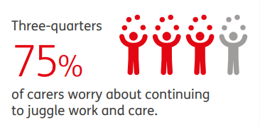
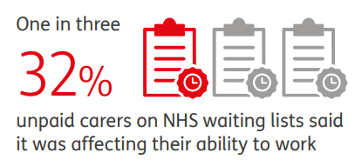
State of Caring report 2022
A snapshot of unpaid care in the UK

Slide 8
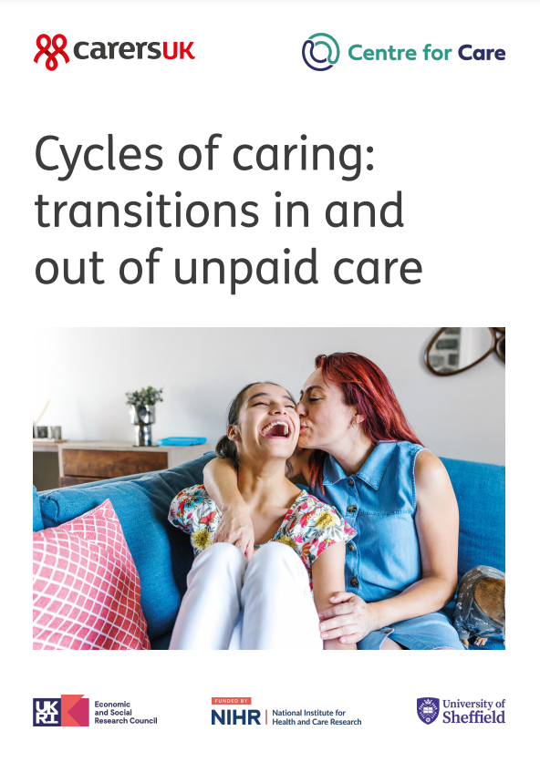
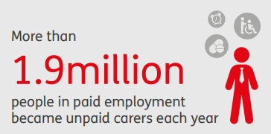
Cycles of caring: Transitions in and out of unpaid care
Carers Rights Day 2022
Over the period 2010-2020, 4.3 million people became unpaid carers every year – 12,000 people a day

